Slide 1
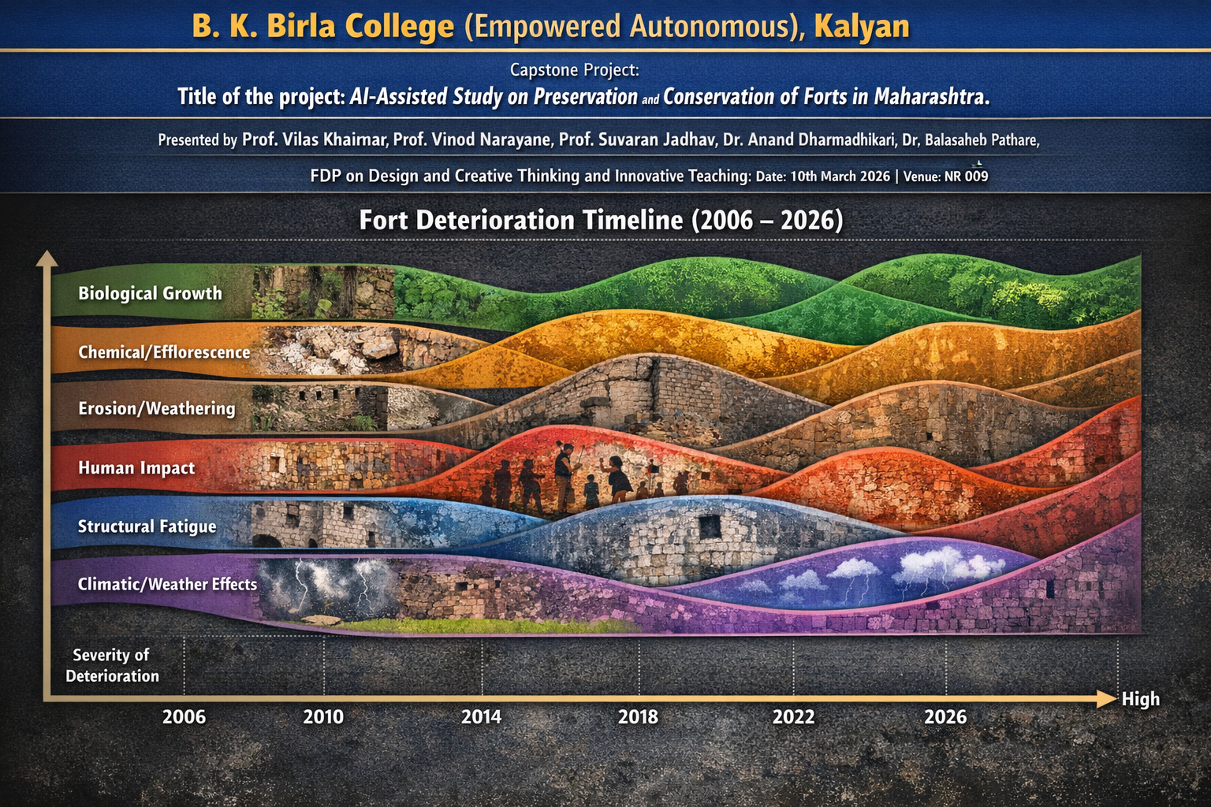
Dr. Dinesh Wanule

Slide 2
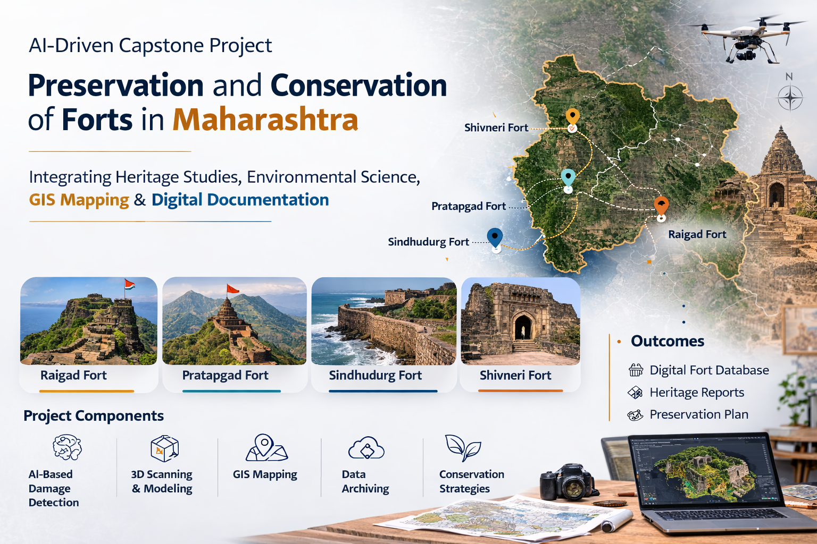
1. Problem Description
Many forts in Maharashtra are damaging due to weathering, vegetation growth, and tourism pressure.
Traditional monitoring methods are manual and time-consuming, making early damage detection difficult.
3. Complexity
The project involves field data collection, AI image analysis, weather data modeling, and GIS mapping.
Integrating these datasets to generate accurate conservation recommendations adds technical and analytical complexity.
2. Justification
AI tools (CNN, GIS, LSTM) can help detect structural damage, analyze environmental impact, and predict damage.
This approach supports efficient heritage conservation and interdisciplinary learning for students.

Slide 3
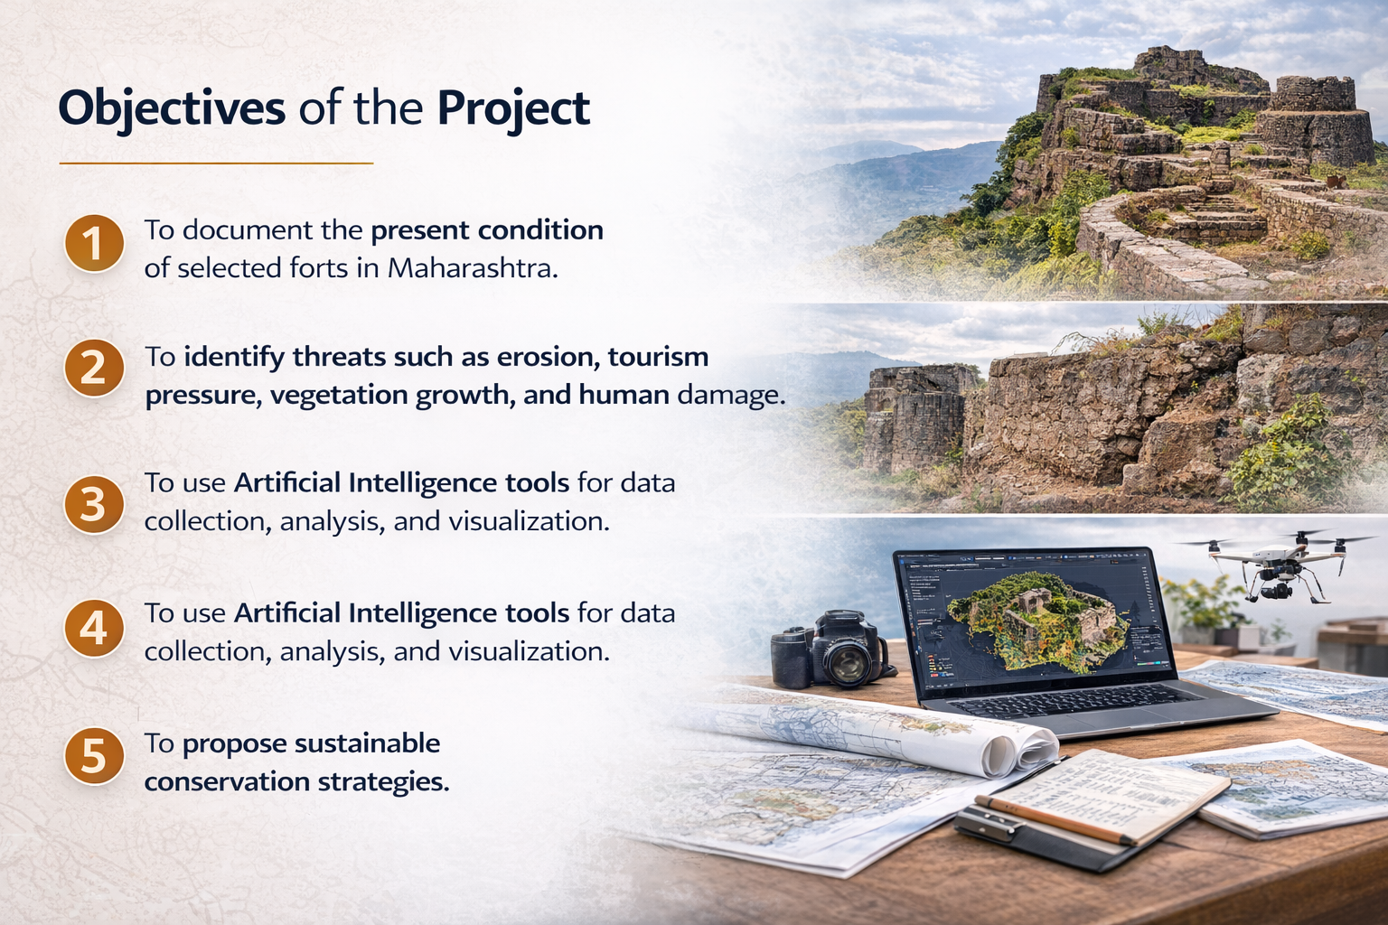

Slide 4
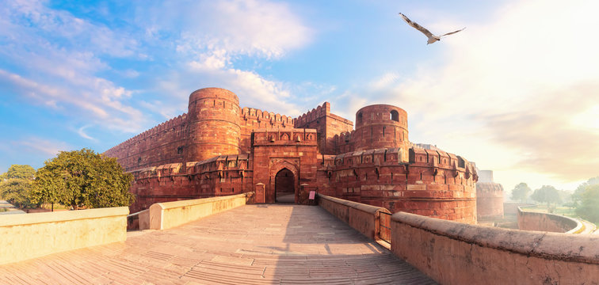
Goals of the Project
The primary goals define what the project aims to achieve:
1. Document Heritage Structures
Digitally record the current state of selected forts (Raigad, Pratapgad, Sindhudurg, Shivneri, etc.) using images, GPS coordinates, and structural data.
2. Identify Damage and Threats
Detect physical damage such as cracks, wall erosion, vegetation overgrowth.
Assess environmental impacts (rainfall, humidity, temperature).
Evaluate human-induced threats (tourism pressure, vandalism).
3. Integrate AI for Analysis
Use AI tools to automate image analysis, weather trend analysis, and GIS mapping.
Predict deterioration patterns using time-series forecasting (e.g., LSTM models for weather impact).
4. Propose Sustainable Conservation Measures
Recommend eco-friendly restoration and tourism management strategies.
Suggest priorities for urgent intervention based on AI predictions.
5. Enhance Educational Outcomes
Improve students’ skills in AI, heritage documentation, digital mapping, and research methodology

Slide 5
Table-1: Capstone Project Planning
Phase | Stages | Activity (AI-Assisted Project on Fort Conservation)
Scope | Topic Identification | Brainstorming on issues related to preservation of forts in Maharashtra; selection of study fort such as Raigad Fort, Shivneri Fort or Sindhudurg Fort; idea posting and concept mapping.
Empathize | Stakeholder Analysis | Mapping stakeholders (tourists, local communities, historians, conservation agencies); identify needs and issues such as erosion, waste management, vegetation damage and tourism pressure.
Define | Problem Definition | Layout of the research problem: conservation challenges of selected forts; define project objectives and research questions using a holistic view.
Ideate | Solution Design | Reflection on collected information; brainstorming possible AI solutions such as image-based damage detection, GIS mapping, digital heritage documentation; identify modules and team roles.
Prototype | Model Development | Develop AI-assisted framework: data collection (photos, satellite images), micro-modules such as damage analysis, environmental risk mapping, digital fort map and heritage awareness content.
Validation | Testing and Verification | Test AI tools and analysis results; compare findings with literature, conservation reports, and field observations; verify whether project objectives are achieved.
Implementation | Deployment | Present AI-assisted conservation insights; propose preservation strategies such as visitor management, structural monitoring, digital documentation and heritage awareness programs.
Report | Documentation and Reflection | Prepare final project report, presentation, and reflection on learning outcomes; suggest future improvements for fort conservation using AI.

Slide 6
Requirements and Specifications
These are the technical and functional requirements that the AI component of the project should fulfill:
A. Data Collection Requirements
Input Types
Images of fort structures (walls, gates, water tanks, temples)
GPS coordinates and mapping data
Environmental and weather data (temperature, rainfall, humidity, wind)
Historical and archival documents
Data Volume & Quality
High-resolution images for accurate analysis
Consistent format for time-series weather data
B. AI Functional Requirements
Image Analysis
Detect cracks, erosion, moss/algae growth, and structural damage
Tools: Google Lens, OpenCV, or other computer vision AI
Output: Highlighted images showing damage areas, severity scores
AI-Based Mapping
Generate digital GIS maps of forts
Overlay structural damage and environmental impact
Tools: QGIS, Google Earth, ArcGIS with AI integration
Time-Series Analysis for Weather Impact
Forecast deterioration patterns based on environmental data
Model: LSTM neural networks
Output: Predictive charts linking weather phases to structural damage
C. Non-Functional Requirements
Usability: Student-friendly interface for uploading images and generating reports
Scalability: Ability to handle multiple forts and increasing datasets
Accuracy: High reliability in AI predictions and damage detection
Visualization: Clear graphical outputs (maps, charts, heatmaps)
Integration: Ability to combine AI analysis with GIS and heritage data

Slide 7
AI Solution Model
AI Image Analysis
Use Computer Vision (CNN models) to detect:
Wall cracks
Vegetation growth (moss, algae)
Structural damage and erosion
Output: Annotated images with damage indicators and severity levels.
AI-Based Mapping
Create GIS-based digital maps of forts.
Tools: QGIS, ArcGIS, Google Earth.
Output: Fort topography and location of gates, walls, temples, water tanks, and damage zones.
Weather-Based Prediction
Use LSTM (Long Short-Term Memory) neural networks to analyze time-series weather data.
Output: Predict erosion risk, vegetation growth, and structural damage trends.
AI-Assisted Historical Documentation
Use NLP to summarize archival texts and CNN to classify historical images.
Output: Automated historical summaries and timelines of forts.

Slide 8
Table 2: Tools, Outcomes and Evaluation Rubrics
Capstone Project: AI-Assisted Study on Preservation and Conservation of Forts in Maharashtra
Stage | Tool | Outcome | Metrics / Rubrics
Scope | Brainstorming tools (Miro, Jamboard), AI tools like ChatGPT | Identification of key issues in preservation and conservation of forts in Maharashtra | Clarity of topic selection, relevance of conservation issue, quality of brainstorming ideas
Empathize | Stakeholder mapping tools, survey forms (Google Forms), field observation | Understanding needs of stakeholders such as tourists, local communities, historians, and conservation authorities | Quality of stakeholder analysis, number of responses collected, identification of real problems
Define | Concept mapping tools, literature review databases, AI summarization tools | Clearly defined conservation problem and research objectives for selected fort (e.g., Raigad Fort or Shivneri Fort) | Clarity of research question, logical problem statement, literature support
Ideate | AI brainstorming tools, design thinking techniques, mind-mapping software | Generation of innovative AI-based solutions for monitoring, documentation, and preservation | Creativity of ideas, feasibility of solutions, number of alternatives explored
Prototype | GIS mapping tools (Google Earth), image analysis tools, AI visual tools | Development of prototype modules such as digital fort map, damage detection model, heritage awareness content | Functionality of prototype, accuracy of mapping/data analysis, clarity of design
Validation | Data comparison tools, expert feedback, peer review | Testing whether the AI tools and analysis correctly identify conservation needs | Reliability of results, feedback from experts/teachers, alignment with project objectives
Implementation | Presentation software, awareness materials, digital documentation | Demonstration of AI-based conservation strategy and practical recommendations | Practical applicability, clarity of implementation plan, quality of presentation
Report | Report writing tools, reference managers, plagiarism checker | Final capstone report and reflection on project findings and learning outcomes | Report structure, scientific accuracy, originality, quality of conclusions

Slide 9
Thank You!

Slide 10
